Slide 1

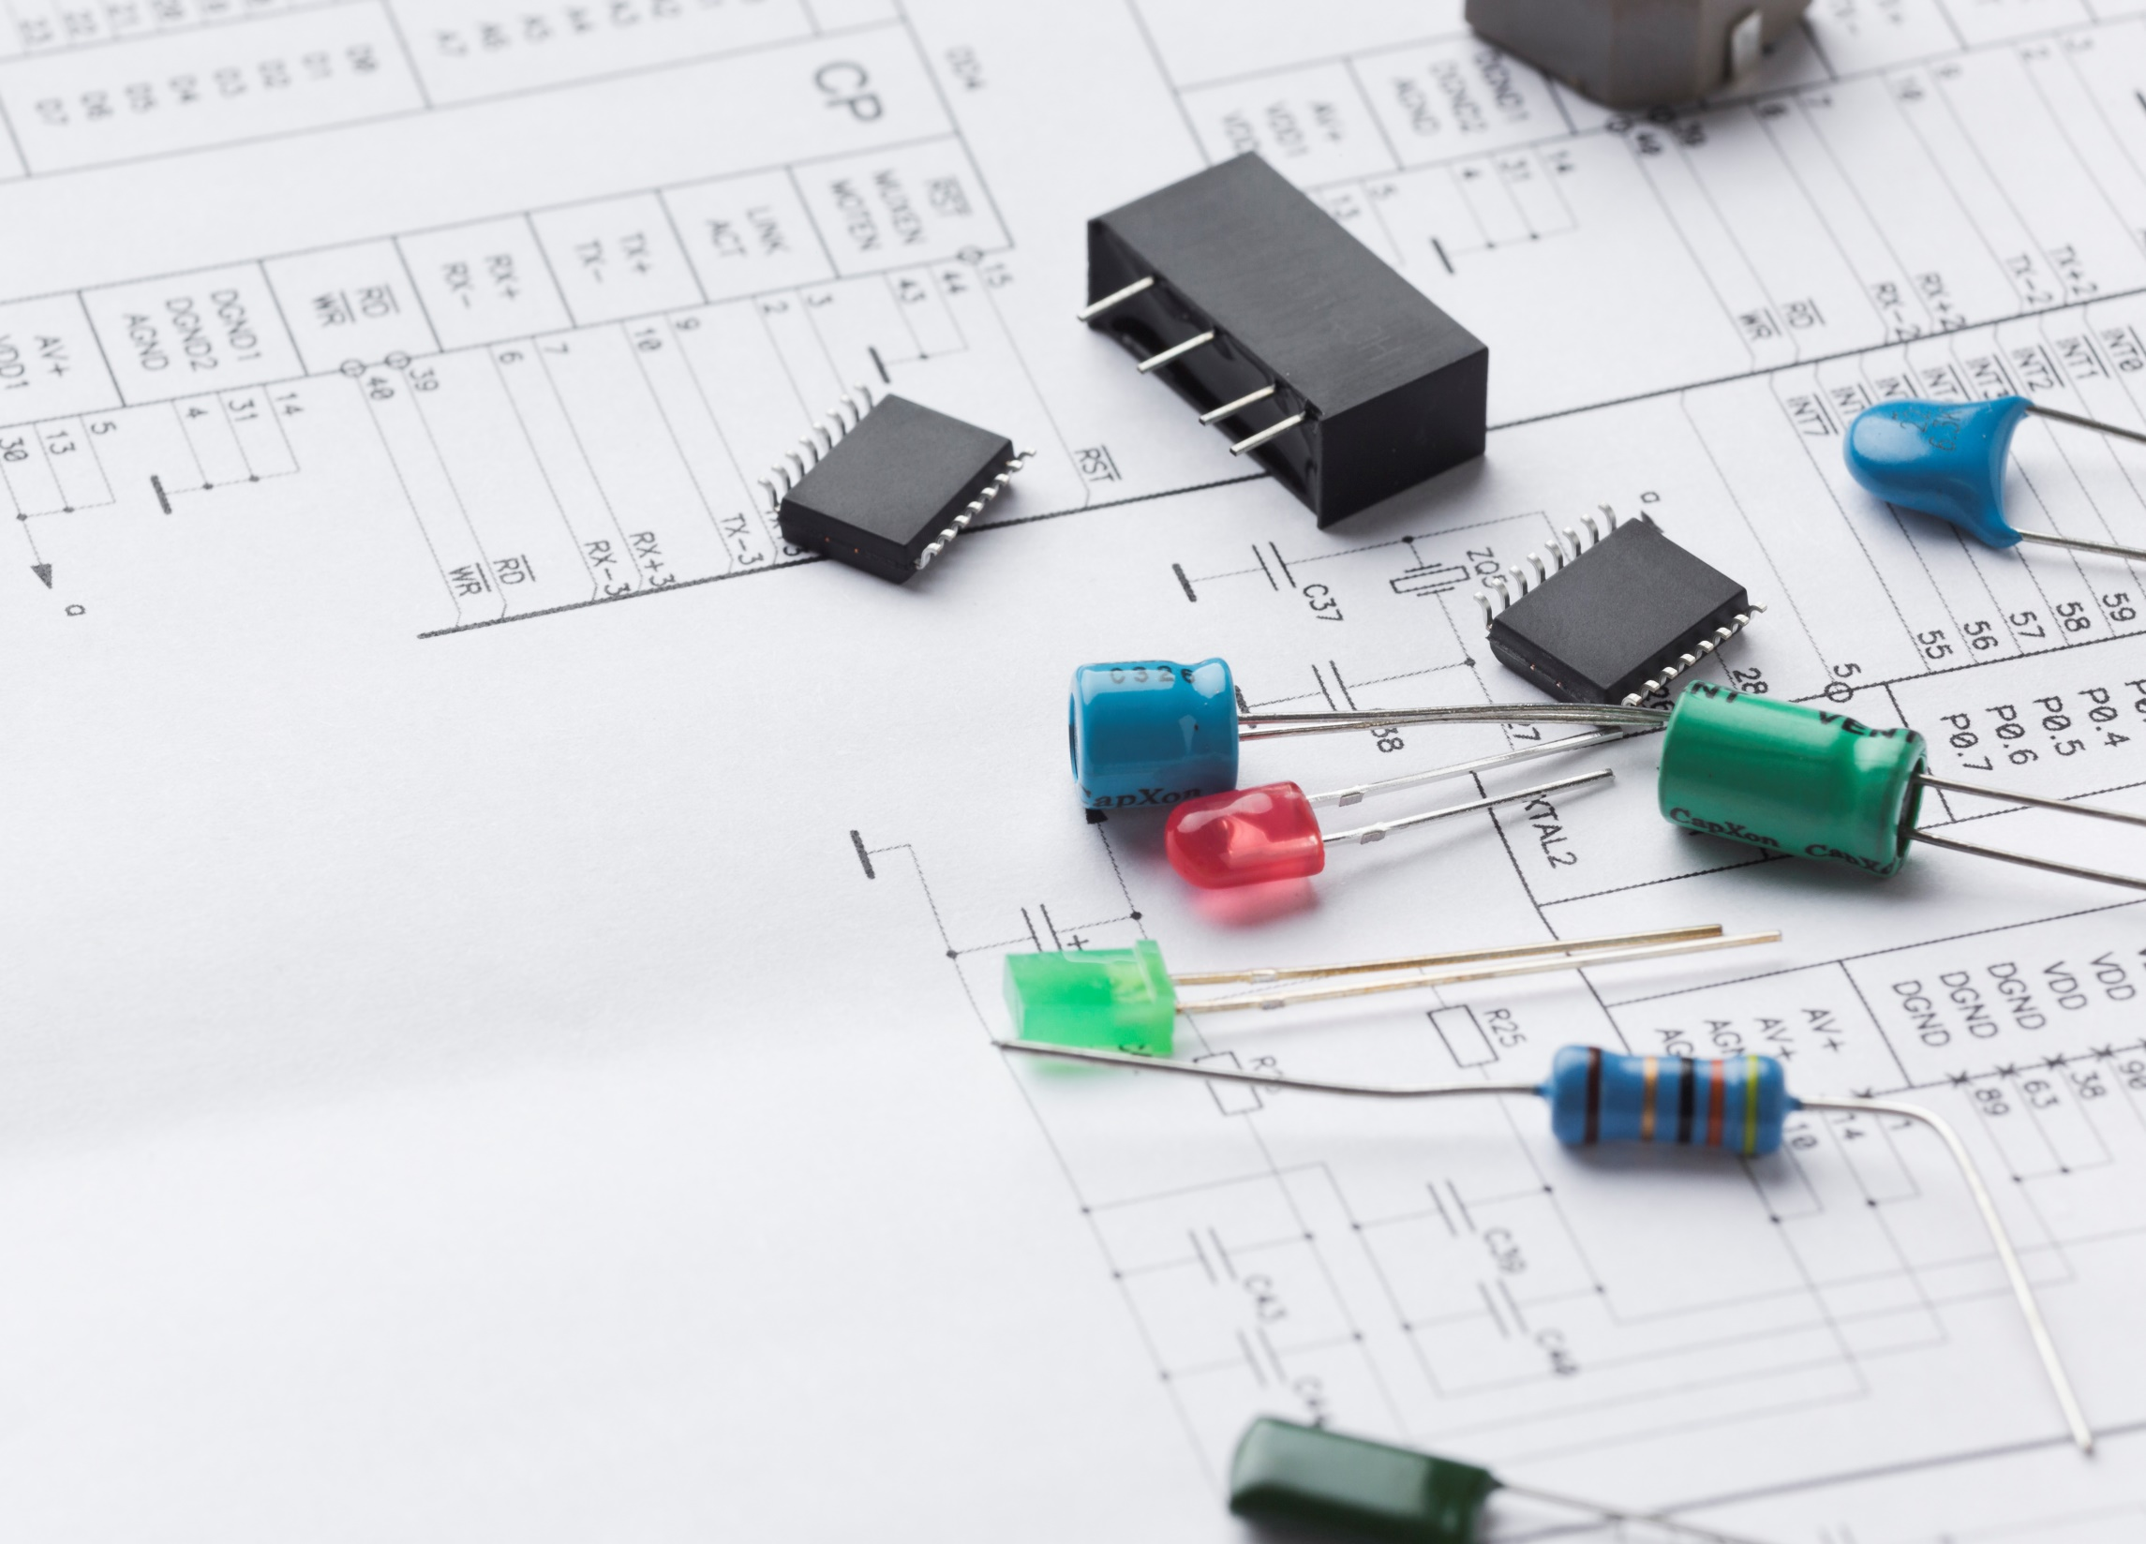

GUI
CONTROLLED
WIRELESS CAR

Slide 2
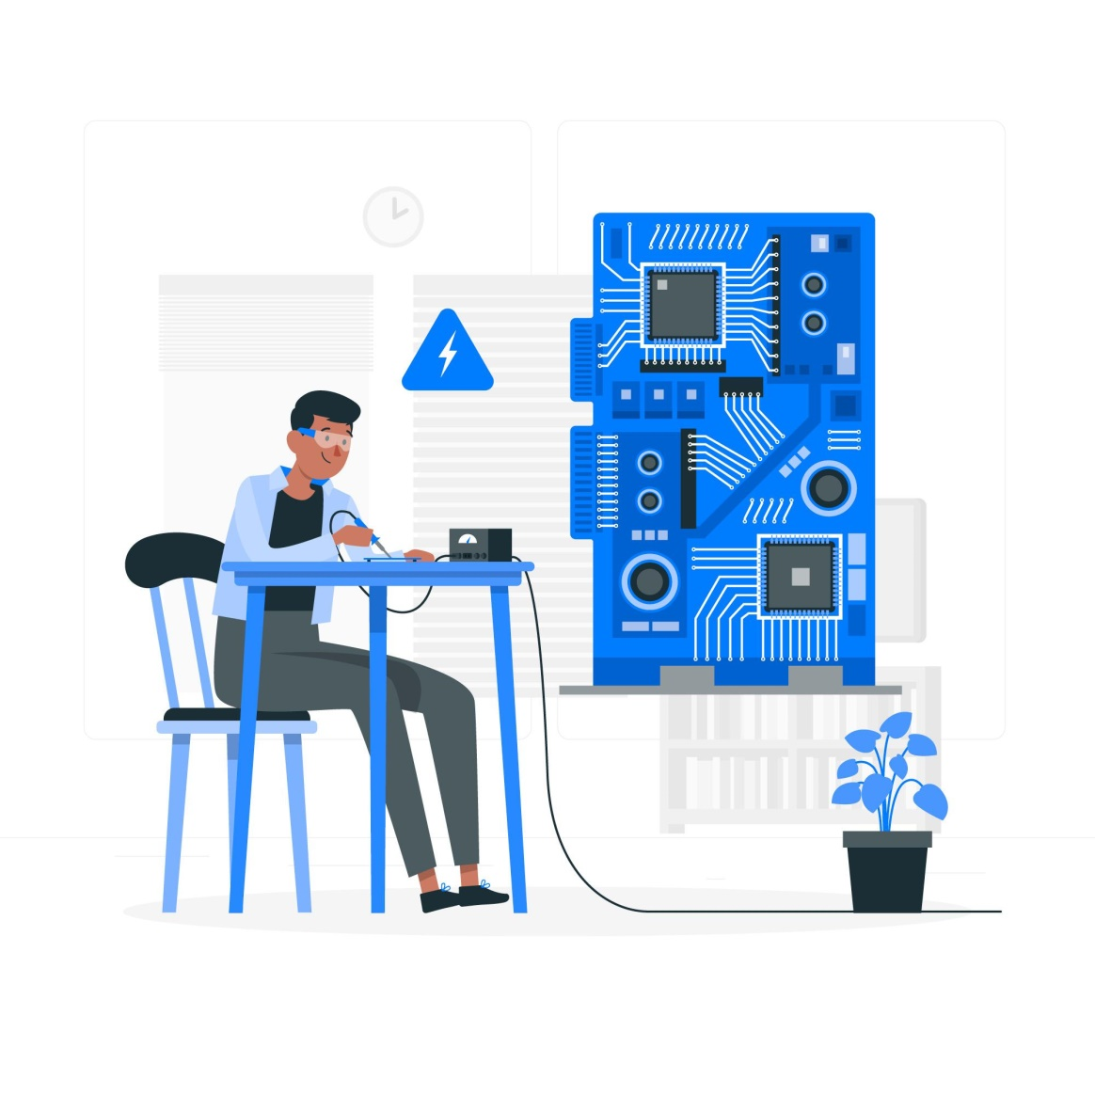

INTRODUCTION :
The GUI-controlled car project is an exciting venture that combines the power of Arduino microcontrollers and graphical user interfaces (GUI) to control a small car wirelessly. By leveraging the Arduino platform, we can create a customizable and interactive experience that allows users to remotely maneuver the car using graphical user interface.

Slide 3
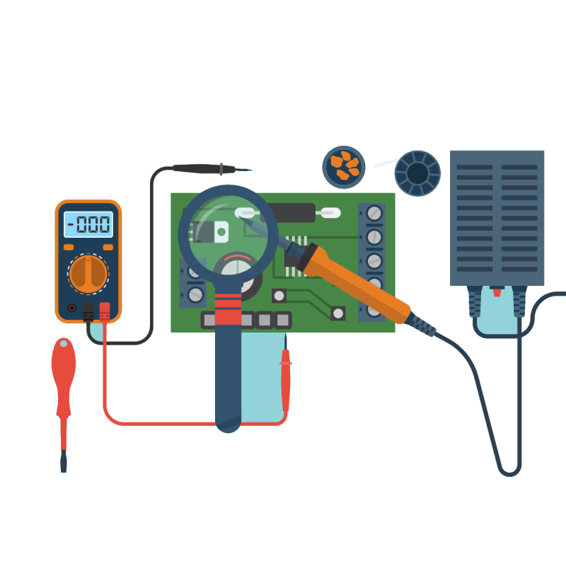
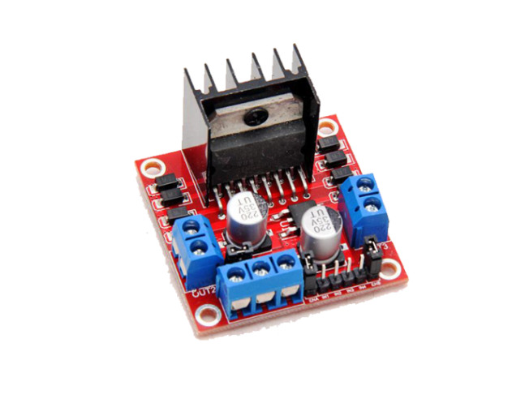
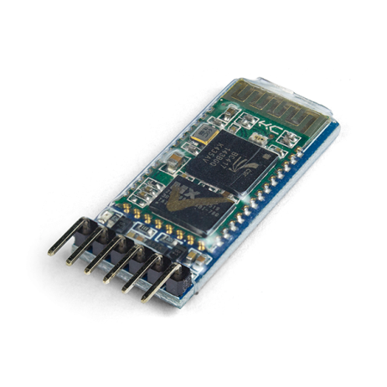
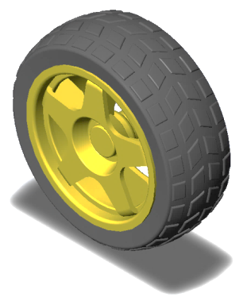
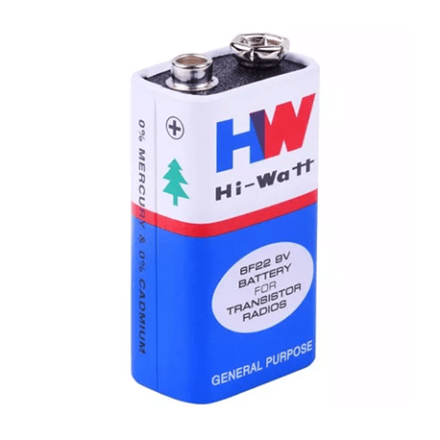
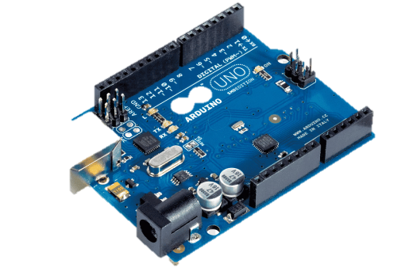
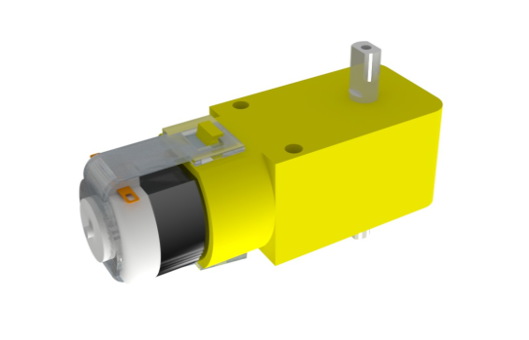
REQUIRED
COMPONENTS :

Slide 4
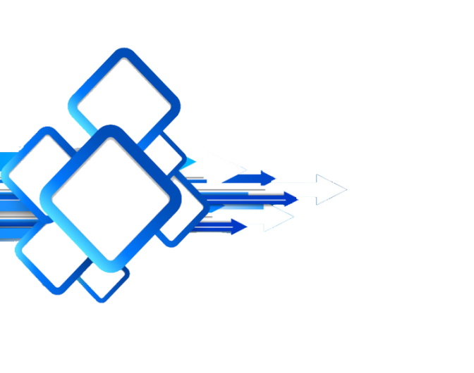
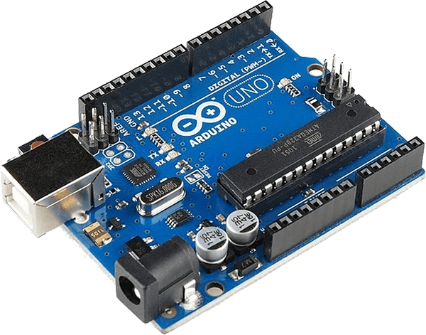
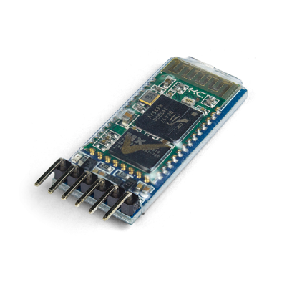



ARDUINO
UNO
Microcontroller Board Based On Atmega328p.
14 Digital Input/Output Pins
(6 Can Be Used As Pwm Output)
6 Analog Inputs
16 Mhz Ceramic Resonator
USB Connection
Power Jack
ICSP Header And A Reset Button.

Slide 5


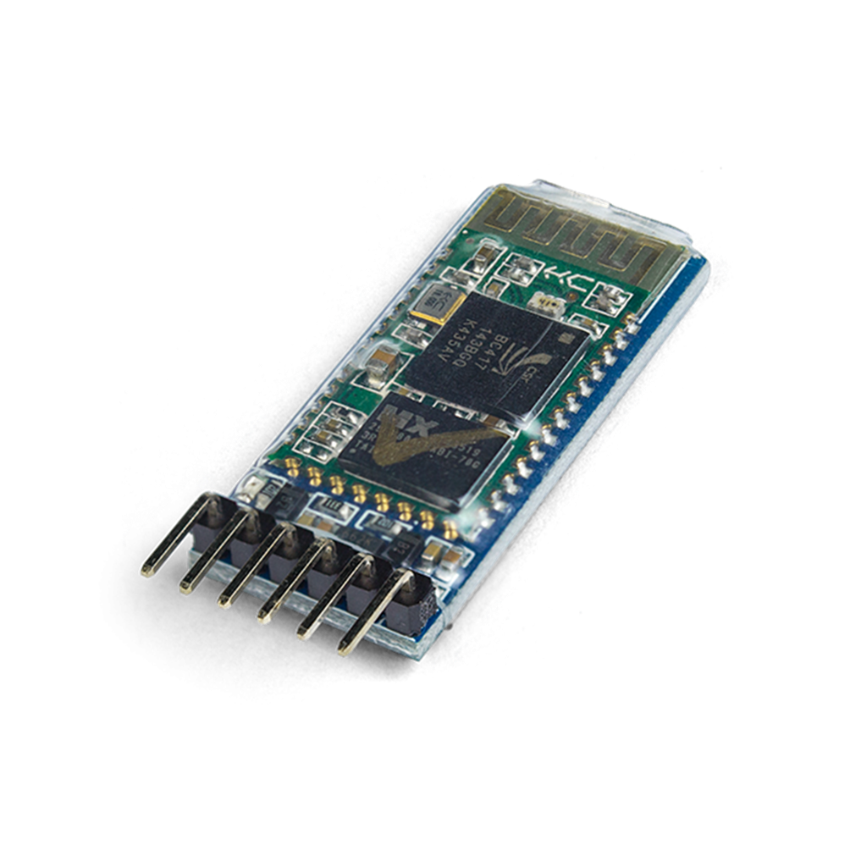
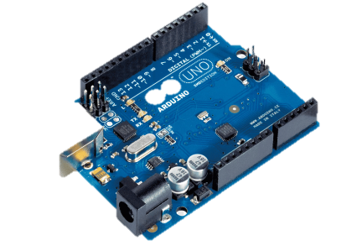
HC-05
Bluetooth
Module
Wireless Module
Power Supply - +3.3 VDC ,50mA
Frequency – 2.4GHz
Built-in chip antenna
Bluetooth core V2.0 compliant

Slide 6
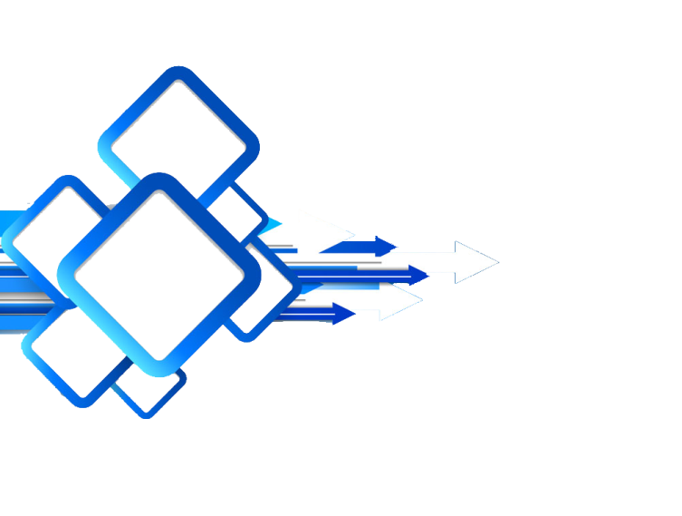



L298
Motor Driver
Operating Voltage : 5- 35
Continous Current 0-36mA
Peak Current(A) - 2
No of channel – 2
Over – Current & Tharmal protection
Power-On Led Indicator
Maximum motor supply current 2A

Slide 7
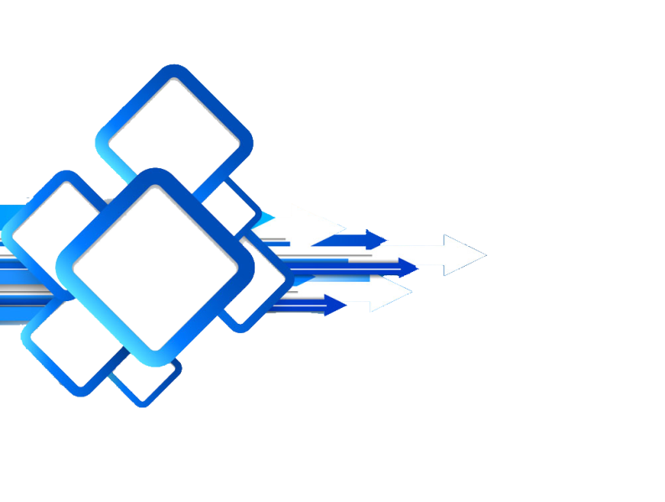
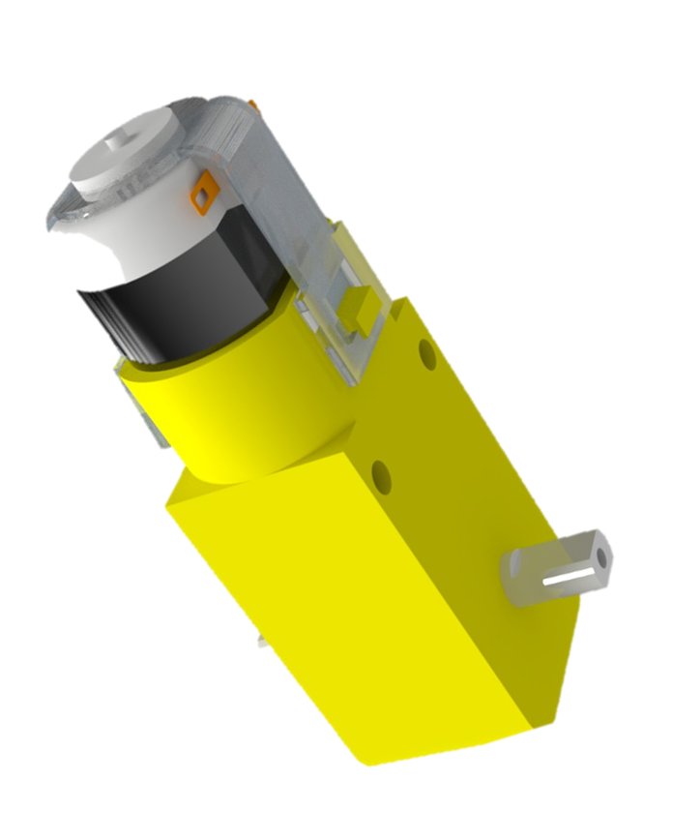

GEAR
MOTOR
Speed – 100 RPM
Vltage – 12 Voltage
No Load current – 40-80ma
Operating Voltage – 3v-12v DC

Slide 8

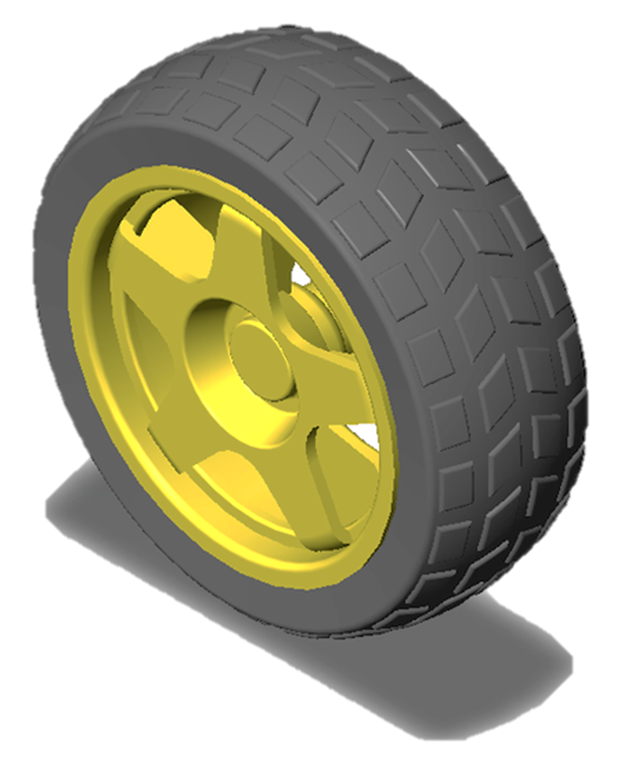



Diameter – 65mm
Meterial of Wheel – High-
strength Plastic
Meterial of Tyre – Rubber
Color - Yellow
WHEEL

Slide 9


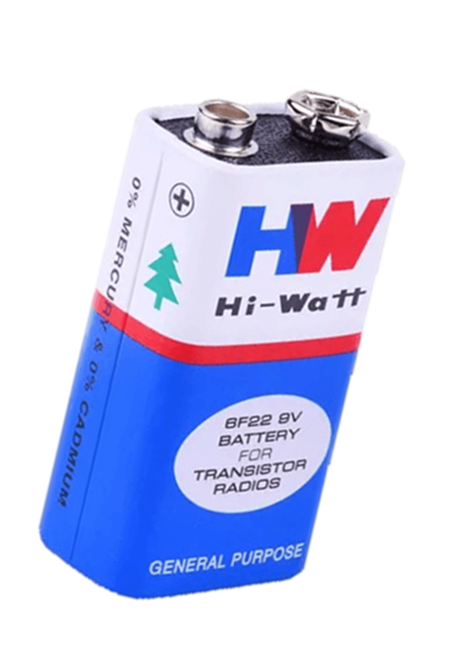
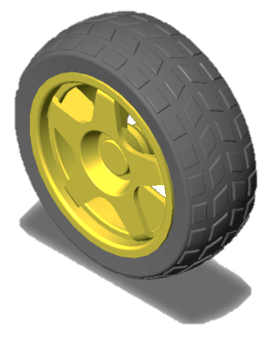
BATTERY
Voltage – 9 volts
Cell Components – Zinc Carbon
Reusability – Single Use

Slide 10

What is Python ?
Python is a popular general-purpose programming language. It was created by Guido van Rossum, and released in 1991. It used for -
Web Development (server-side)
software development
Mathematics
system scripting
Game Devolopment etc.

Slide 11
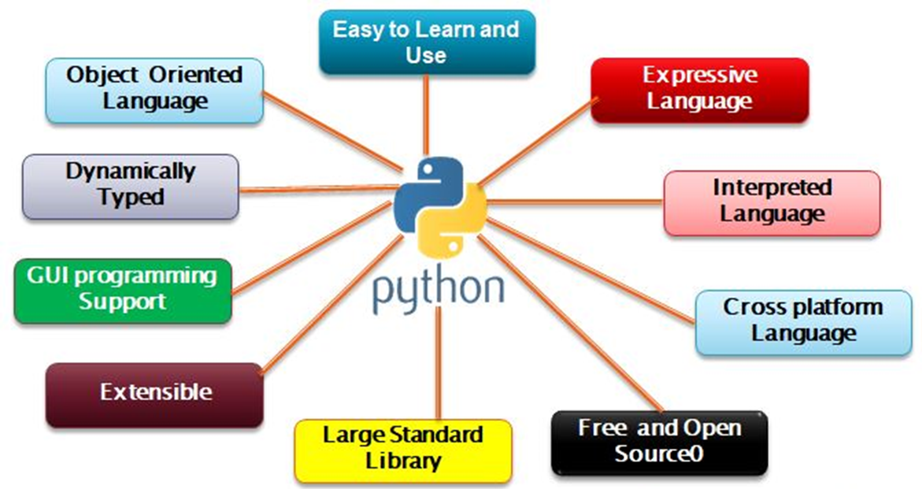
Features of Python :

Slide 12


?

Slide 13
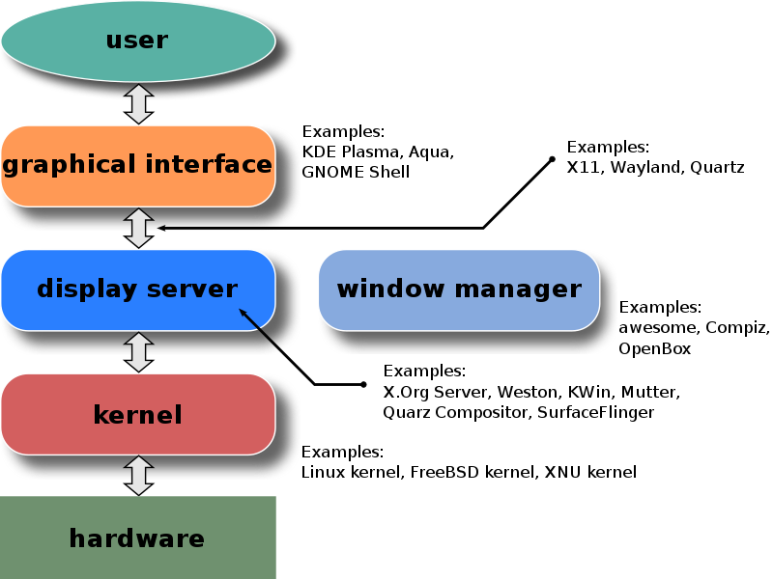
GUI : The graphical user interface, or GUI, is a form of user interface that allows users to interact with electronic devices through graphical icons and audio indicator such as primary notation, instead of text-based UIs, typed command labels or text navigation.

Slide 14
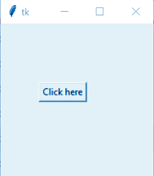
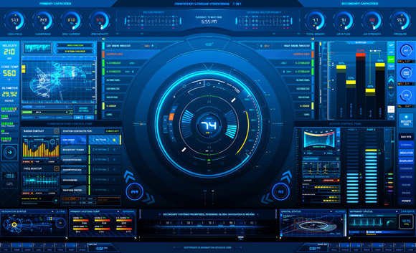
Examples :

Slide 15
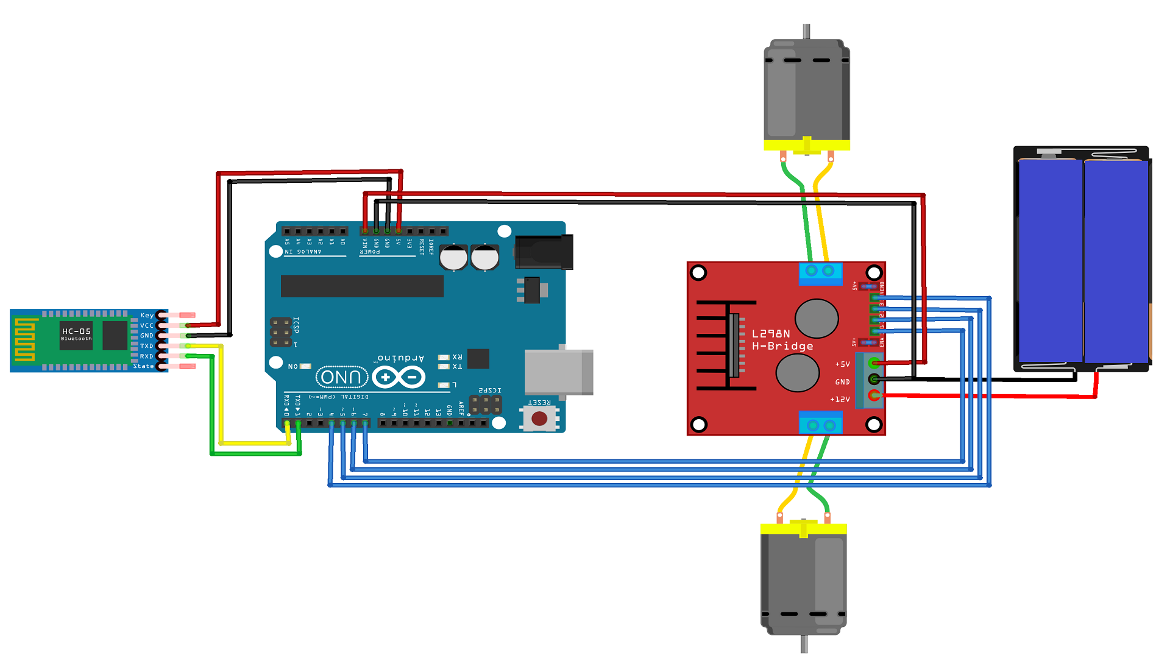
Arduino Setup :
Gear Motor
HC 05 Bluetooth Module
Battery
Arduino UNO
Motor Driver

Slide 16
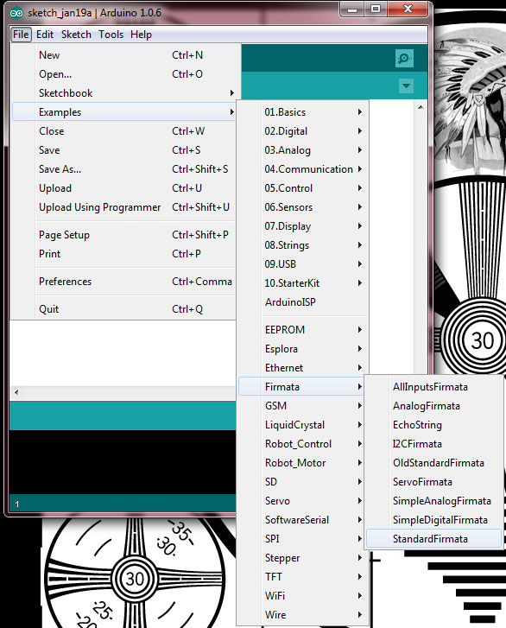


Arduino Code :
Firmata : Firmata is a protocol and firmware that allows for easy communication between software running on a computer and Arduino microcontrollers.
Steps to upload Firmata -

Slide 17
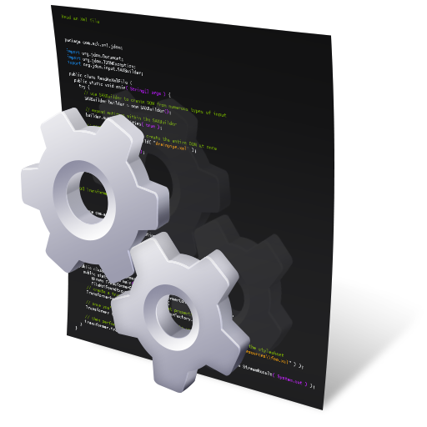
Python Setup:
pyfirmata is a Python interface for the Firmata protocol
from pyfirmata import Arduino
import time
from pynput.keyboard import Key , Listener
board = Arduino('COM3')
pin_3 = board.get_pin('d:3:p')
pin_6 = board.get_pin('d:6:p')
pin_2 = board.get_pin('d:2:o')
pin_4 = board.get_pin('d:4:o')
pin_5 = board.get_pin('d:5:o’)
pin_7 = board.get_pin('d:7:o')
speed = 0.6
Pynput is a library. It’s allows to control and monitor input devices.
(mouse and keyboard )

Slide 18
Command for Car’s control :
def forward():
global speed
pin_3.write(speed)
pin_5.write(0)
pin_7.write(1)
pin_6.write(speed)
pin_2.write(0)
pin_4.write(1)
def stop():
pin_3.write(0)
pin_5.write(0)
pin_7.write(0)
pin_6.write(0)
pin_2.write(0)
pin_4.write(0)
def reverse():
global speed
pin_6.write(speed)
pin_2.write(1)
pin_4.write(0)
pin_3.write(speed)
pin_5.write(1)
pin_7.write(0)
def turn_right():
global speed
pin_6.write(speed)
pin_2.write(1)
pin_4.write(0)
pin_3.write(speed)
pin_5.write(0)
pin_7.write(1)
def turn_left():
global speed
pin_6.write(speed)
pin_2.write(0)
pin_4.write(1)
pin_3.write(speed)
pin_5.write(1)
pin_7.write(0)
def start_car():
app.destroy()
def exit():
app.destroy()

Slide 19
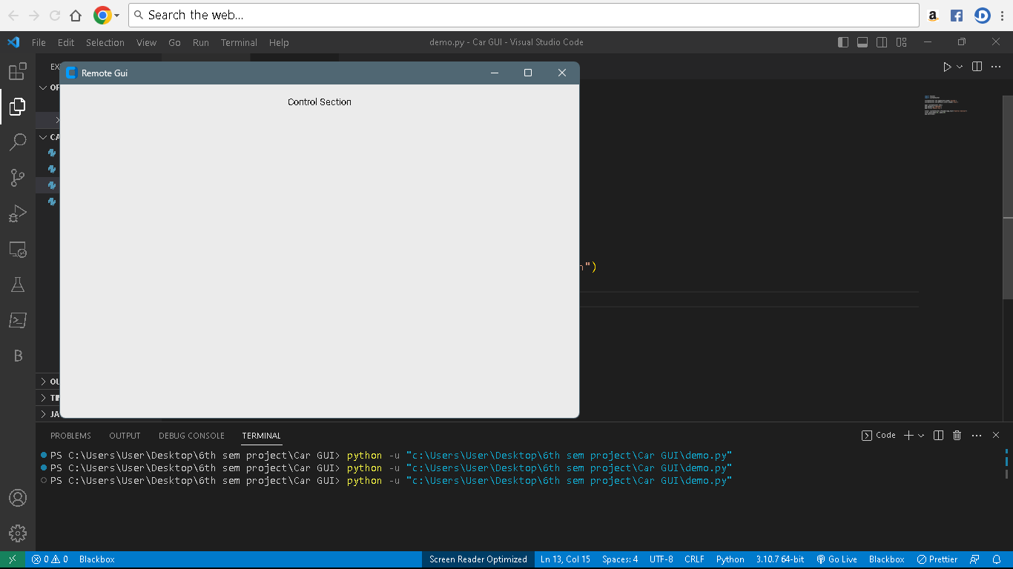
GUI Design :
Tkinter is a standard GUI library for python. It provide a fast & easy way to creat GUI.
Import threading
import tkinter
import customtkinter
customtkinter.set_appearance_mode('System')
customtkinter.set_default_color_theme('blue')
app= customtkinter.CTk()
app.geometry("700x450")
app.title("Remote Gui")
titel= customtkinter.CTkLabel(app,text="Control Section")
titel.pack(padx=10, pady=10)
app.mainloop()

Slide 20
Button Section :
button1 = customtkinter.CTkButton(app,text="Start" , command= start_car )
button1.pack(padx=2, pady=2)
button2 = customtkinter.CTkButton(app, text="Stop" , command= stop)
button2.pack()
button3 = customtkinter.CTkButton(app, text="Exit" , command= exit)
button3.pack( padx=20, pady=20)
button4 = customtkinter.CTkButton(app, text="Forward" , command= forward)
button4.pack(padx=50, pady=30) button5 = customtkinter.CTkButton(app, text="Left" , command= turn_left)
button5.pack(side=customtkinter.LEFT, padx=50, pady=10) button6 = customtkinter.CTkButton(app, text="Right" , command= turn_right)
button6.pack(side=customtkinter.RIGHT, padx=50, pady=10) button7 = customtkinter.CTkButton(app, text="Reverse" , command= reverse)
button7.pack(side=customtkinter.BOTTOM,padx=20, pady=20)

Slide 21
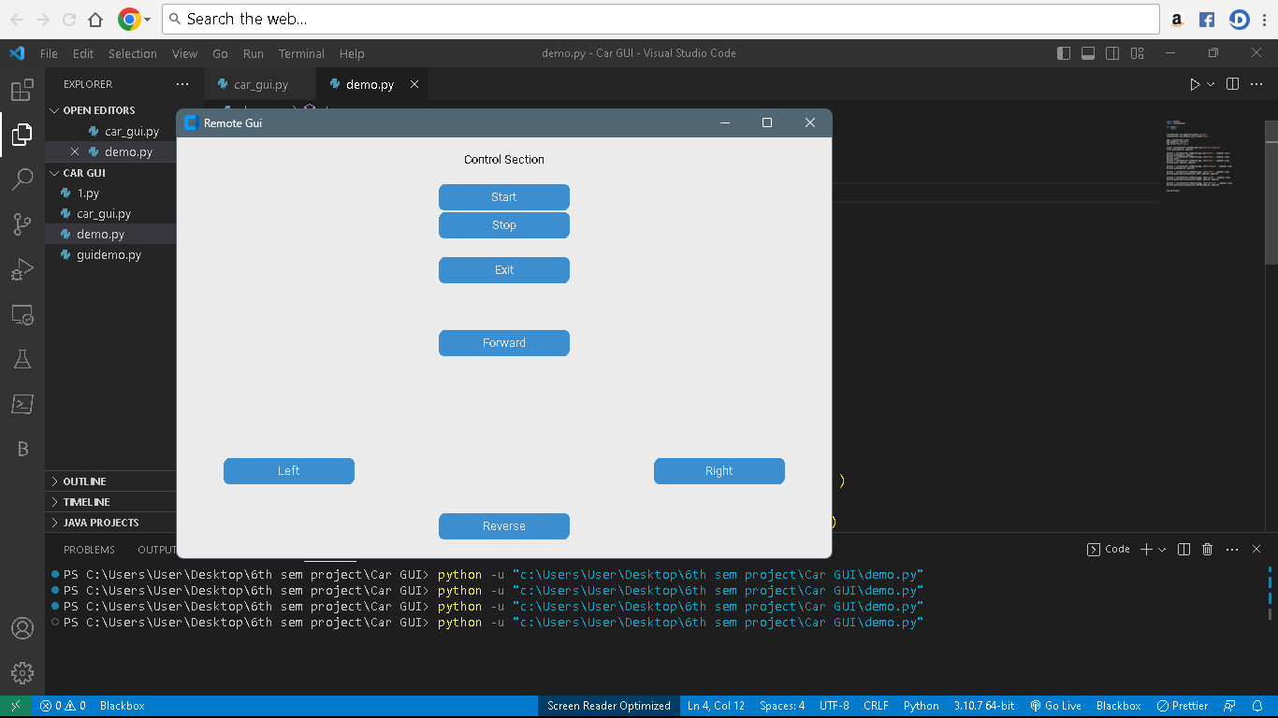

Slide 22

CONCLUSION
In conclusion, the GUI-controlled Arduino car project offers an exciting opportunity to delve into the realms of robotics, programming, and user interface design. By combining Arduino microcontrollers, motor drivers, wireless communication, and a graphical user interface (GUI), this project provides a customizable and interactive experience.
Throughout the project, you learned how to assemble a small car chassis equipped with an Arduino board, motor drivers, and wheels. You explored the process of uploading the Firmata firmware to the Arduino, establishing a communication channel between the Arduino and the GUI.
The GUI served as the control interface, allowing users to remotely maneuver the car using a computer or mobile device. With the GUI, you provided intuitive controls such as directional buttons, speed sliders, or even accelerometer-based control, enhancing the user experience.

Slide 23

REFERENCE :
Arduino Forum: The Arduino Forum (https://forum.arduino.cc/) is a community platform. Which is valuable resource for finding project ideas, troubleshooting, and seeking guidance.
GitHub: GitHub (https://github.com/) , Which is a code repository and collaboration platform that hosts numerous Arduino projects and GUI devolopment.
Python Subreddit and Python Discord: The Python subreddit (https://www.reddit.com/r/python/) and Python
Discord community (https://discord.gg/python)
Online Tutorials and Project Blogs: Hackster.io (https://www.hackster.io/), Instructables (https://www.instructables.com/)

Slide 24
Thank
You

